Slide 1

Model Evaluation on Financial Tweets and Stock Trend Prediction
ANLY 580 Final Project
Yunhan Zhang, Kaiyue Wei, Ningyuan Zhou, Qiaojuan Tu
Notes:
hello, everyone, my name is Qiaojuan Tu and here are my group members. Do you guys want to introduce yourself real quick?
Okay, our project topic is “Model Evaluation on Financial Tweets and Stock Trend Prediction”

Slide 2
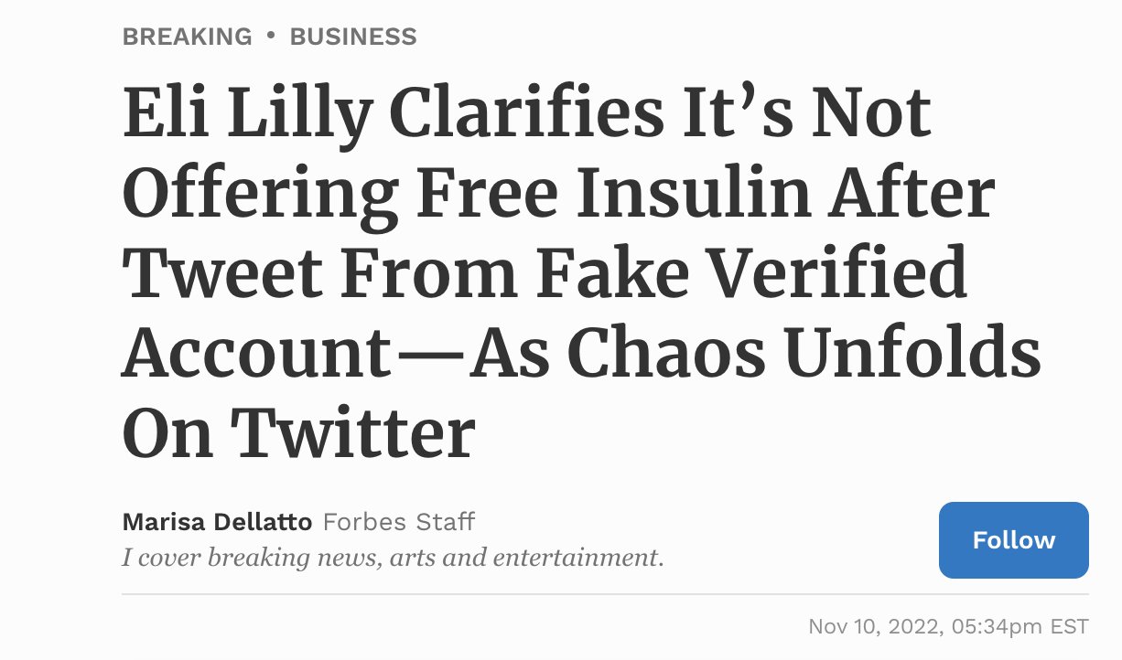
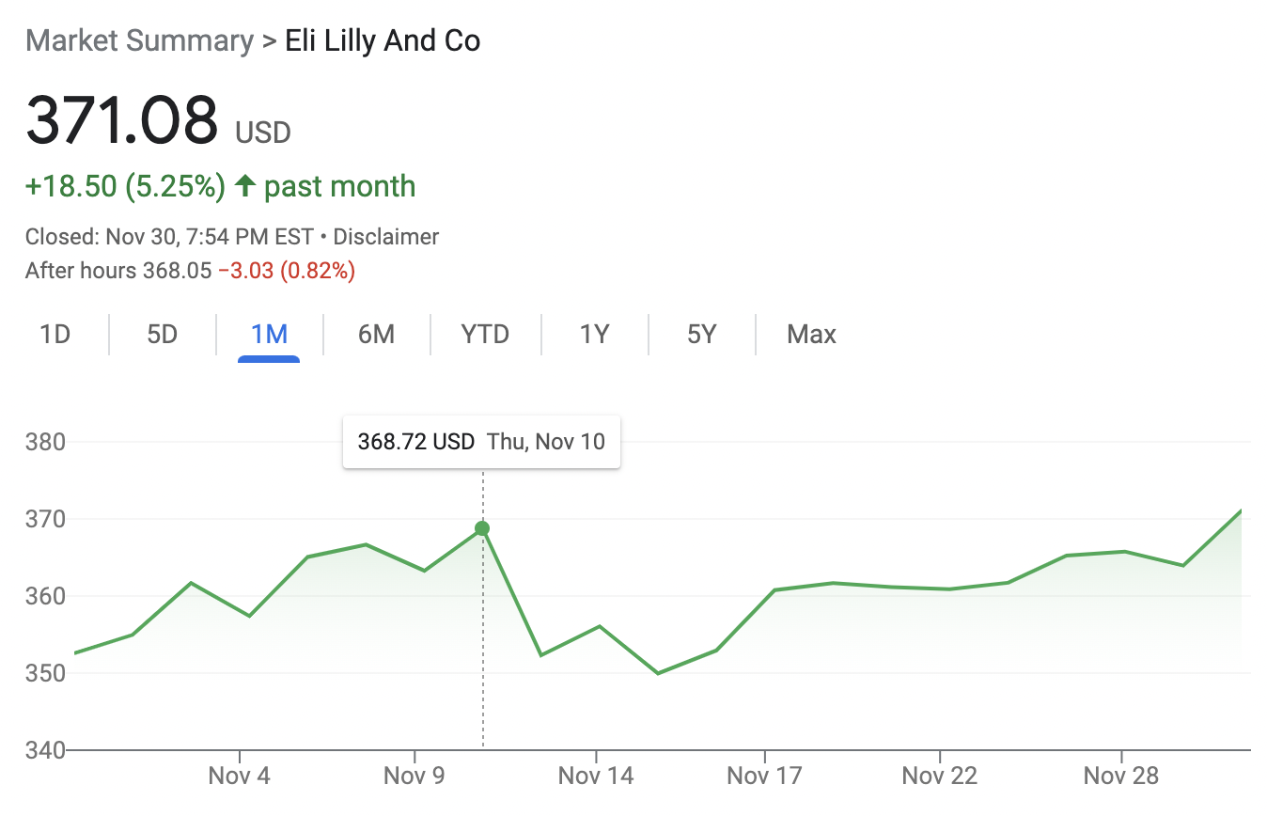
Background/Motivation
Before the internet, there could be a significant lag time between the unfolding of an event and the public’s awareness of it. With the advent of the social media, information could spread more quickly.
Twitter stands out among social media sites as a valuable source of up-to-date breaking news, alerts, and tips that can inform trading decisions.
A single investor can simply monitor Twitter for major announcements and lately financial market trends instead of various websites and other publication channels.
Posts on the social media platform can influence stock returns, according to research led by a West Virginia University financial expert.
https://wvutoday.wvu.edu/stories/2020/11/09/putting-stock-into-twitter-social-media-can-influence-returns-wvu-finance-professor-says
Notes:
Just to give a brief introduction of our topic and talk about what intrigued us to do this project. So before the use of internet, information did get to spread that quickly, and people gain most of their information of news mostly through newspapers and from other people. With the development of internet, people gain information more quickly and could react quickly.
Twitter, a popular social media platform, is a valuable source of up-to-date breaking news, alerts, and tips that can inform trading decisions. So basically, a person can monitor twitter for major announcements, such as companies revenue reports, change of interest rates, government policies etc, to make investment decisions.
There is a study led by a West Virginia University financial expert, saying posts on the social media platform can influence the stock returns. The following is a great example of proving his statements. So on Nov 10, literally the past month, there is a Fake Verified account tweeted that Eli Lilly, one of the largest producers of insulin, will offer free Insulin. The market reacted really quickly, and the next day the stock price dropped nearly 6% and wiped out about billions of dollars of its market cap. This is quite fascinating and interesting to see of how quickly the market reacted to information and news.
Before I continue, I want to do a quick a poll. How many of you invest in stock markets right now? And how many of you watch twitter financial news and make investment decisions? Okay, great choice!

Slide 3
Goals and Objectives
Interested Questions:
Can twitter posts really affect the stock trend?
Can we build a model based on financial tweets and use it to predict the stock index prices trend?
Goal: Build Model on financial tweets to reflect and predict the stock index prices trend
Train model on financial tweets and stock market price index change (Rise/Fall)
Predict the next stock index movement within some time frame by using financial text content
Notes:
Here are the two questions that we wanted to answer from our project, the first one is “Can twitter posts really affect the stock trend?”, and the second one is “Can we build a model based on financial tweets and use to predict the stock index trend?”
Our goal is to build model on financial tweets to reflect and predict the stock index prices trend. We will train our model and use to predict the next stock index movement within some time frame.

Slide 4
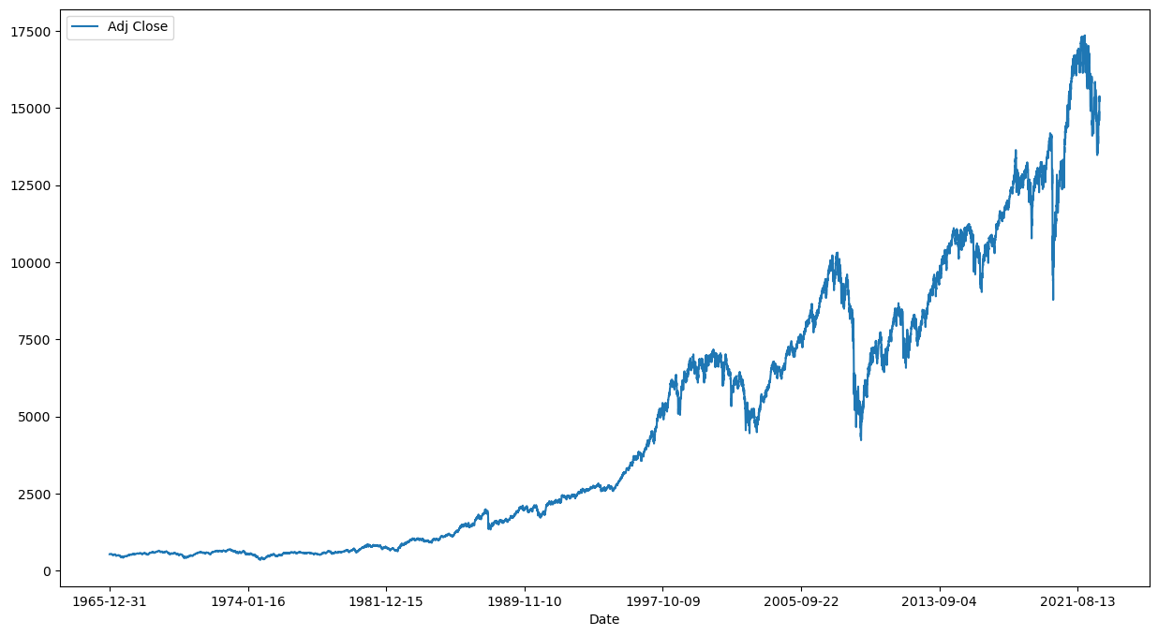
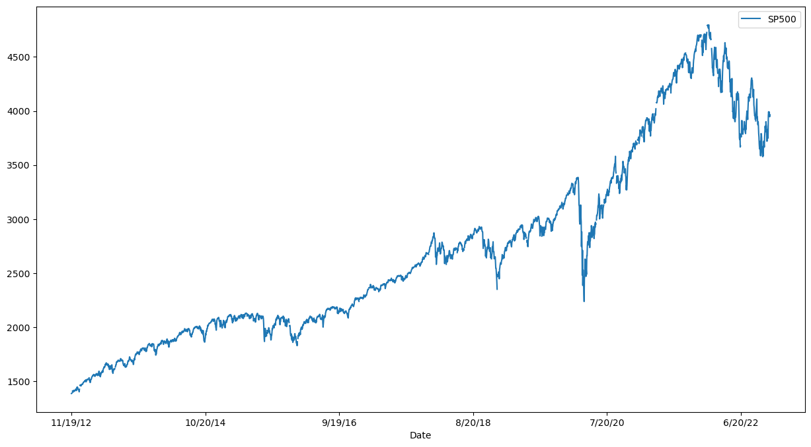
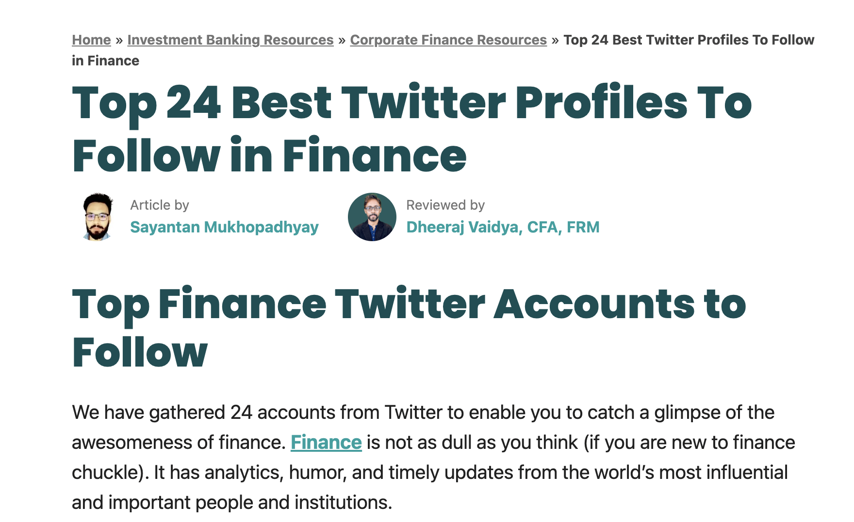
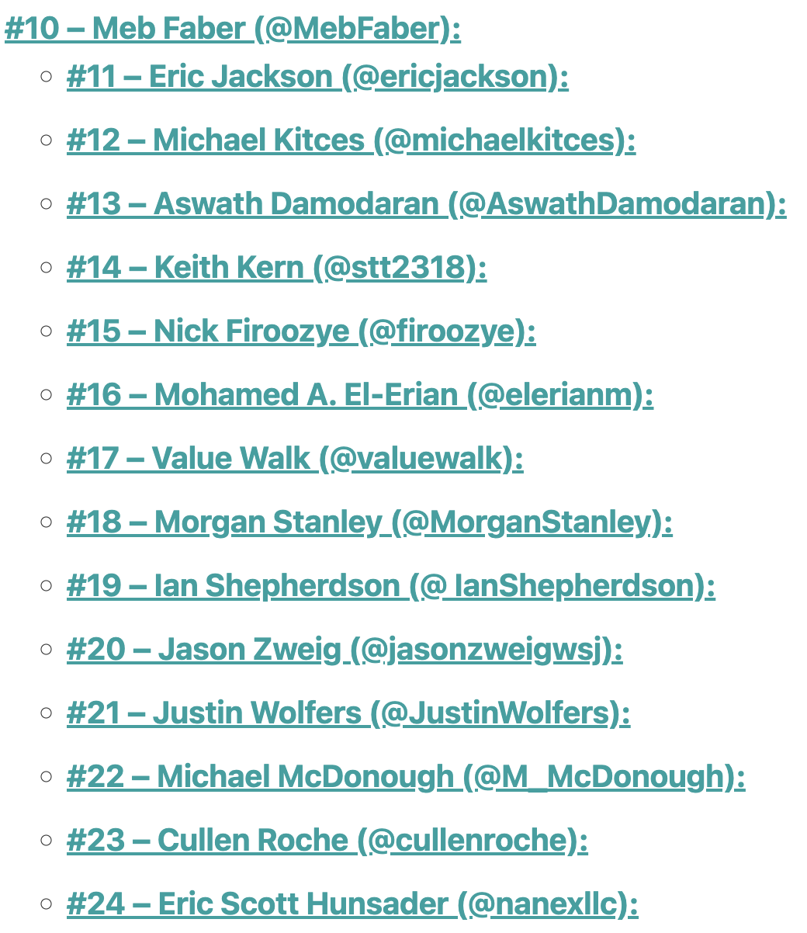
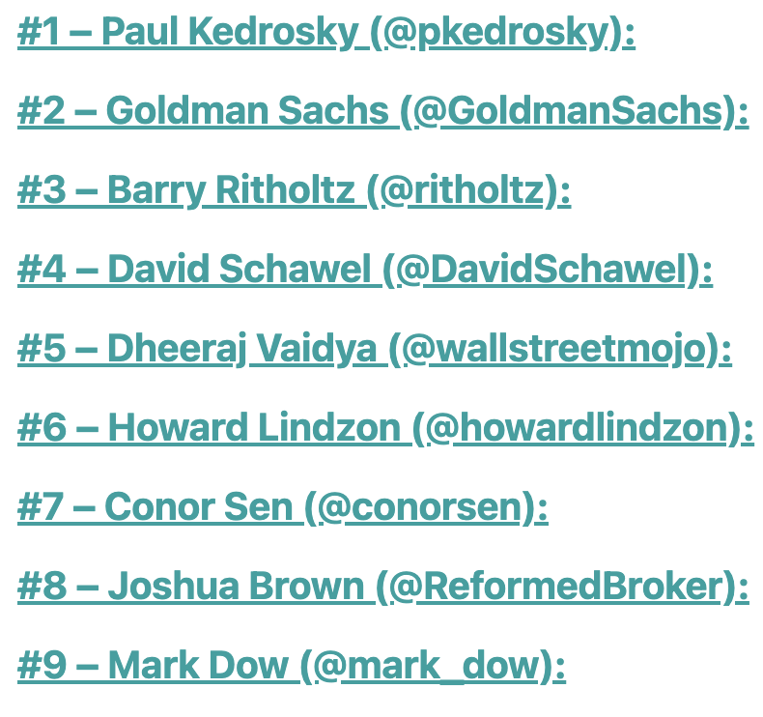
Data Description
S&P 500 and NYSE raw data
S&P 500
NYSE
Financial Tweets: A basket of tweets from each recommended financial account
https://www.wallstreetmojo.com/twitter-profiles-to-follow-in-finance/
Notes:
Here is a quick look of our data: on the top are the two indexes of the stock market that people generally refer to. Standard & Poor 500, and New York Stock Exchange. The two indexes consists of different group of companies where some of them may overlap. On the bottom is an article that we find, saying these are the 24 best twitter profiles that you have to follow in Finance. Goldman Sachs and Morgan Stanley are on there so this list looks reliable. So we went ahead and used twitter api to scraped tweets from all of the 24 accounts that they ever tweeted.

Slide 5
Workflow
Cleaning: make text lowercase and remove stop words, hyperlinks, email, numbers, extra space, and punctuation
Tokenizing
Lemmatization & Stemming
Twitter Text
Modeling & Evaluation
Data Gathering
Pre-Processing
EDA
S&P 500 & NYSE
Weekly stock price
mean diff & last day diff: 𝜇_𝑐𝑢𝑟𝑟𝑒𝑛𝑡 - 𝜇_𝑝𝑟𝑒𝑣𝑖𝑜𝑢𝑠
> 0: RISE / Up
< 0: FALL / Down
Notes:
Now, we have our raw data and then we did some traditional text processing work. We made the text lowercase, and remove stop words, hyperlinks, email, numbers, extra space, and punctuation. We tokenized the text, then lemmatize and stem the words. For the index data, we calculated the weekly stock price mean difference and last day difference using the mean of current week minus the mean of previous week. If the number is greater than 0, the label is RISE, if less than 0 it’s a FALL. Then the next step is EDA and modeling and evaluation.

Slide 6
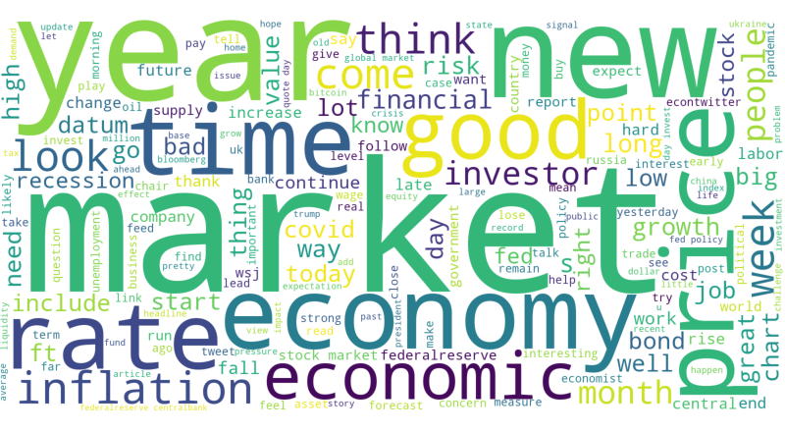
EDA - Tweets Word Cloud
Notes:
Most of the words in our wordcloud is finance or market related which is good. And it make sense that the timing is important when you invest in stock markets.

Slide 7
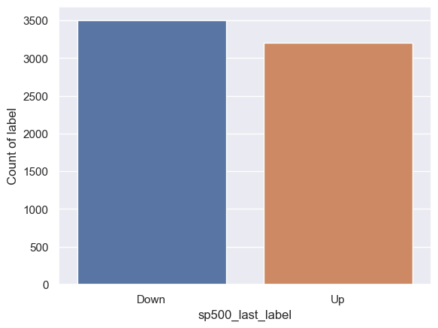
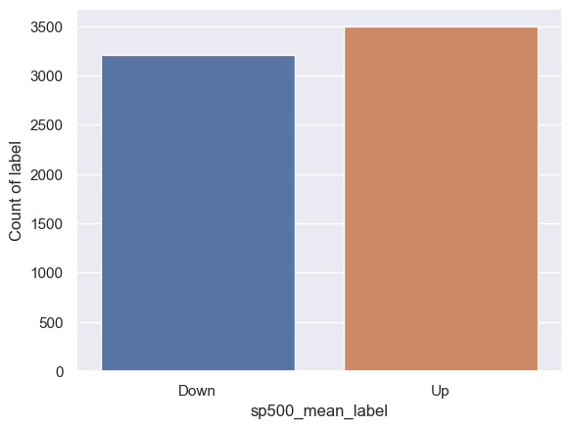
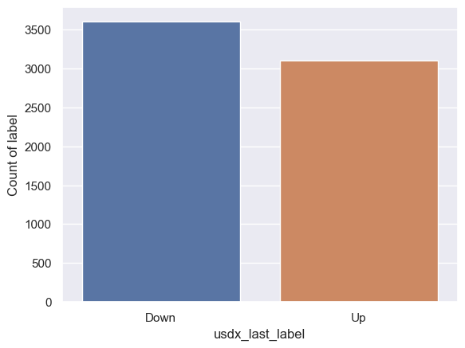
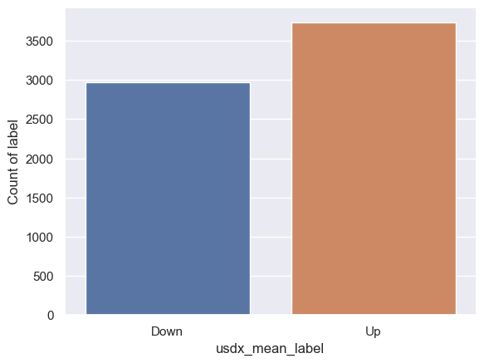
EDA - Rise/Fall Labels Distribution
nyse_last_label
nyse_mean_ label

Slide 8
Pipeline
Weekly Average difference
Pre-Processing
Last Day of the week difference
CountVectorizer
Tokenizing
N-gram CountVectorizer (1:4)
TF-IDF with N-gram (1:4)
Logistic Model
Model
Naive Bayes Model
Evaluation
Notes:
As Tina mentioned before, we are going to use pre-processed tweets generated from financial twitter accounts and two label data with different calculation for both SP500 and NYSE data. Then we break the text into words. Here we tried three different tokenizing tool: the plain CountVectorizer, Ngram CountVectorizer and TF-IDF with N-gram CountVectorizer, because we think simply counting frequencies did not yield good results. By comparing three tokenizing tools, we can choose the best possible numerical representation of the text strings for running models. We choose N-gram to be 1 to 4, because we think 4 can be the most relevant term size to our financial topic.
We are going to use the tokenizing matrix as input to train and test model.
We choose Logistic model and naive bayes classifier as our base model.
After that, i am going to present the evaluation of these base models.

Slide 9
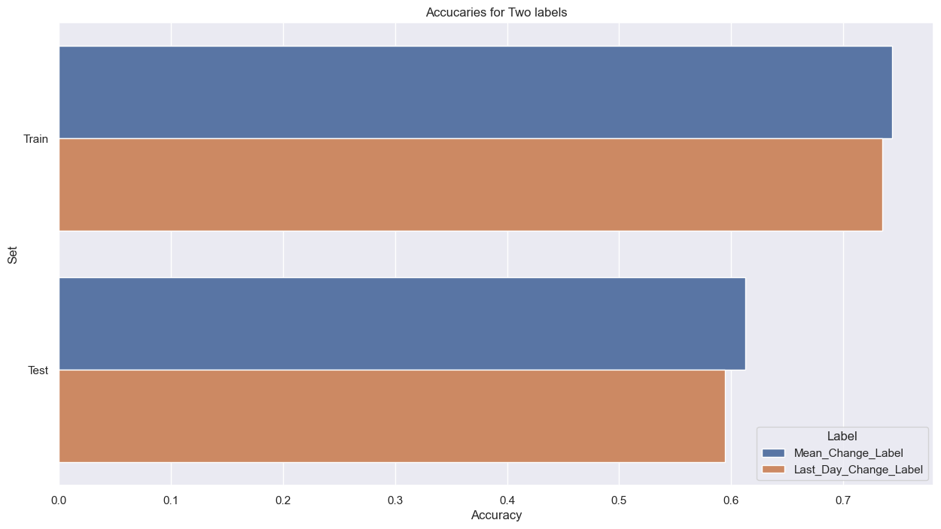
Logistic Model
61.25%
54.69%
Notes:
Both Naive Bayes and Logistic regression are linear classifiers, Logistic Regression makes a prediction for the probability using a direct functional form while Naive Bayes figures out how the data was generated given the results.
After we train the data, we found that the TF-IDF with the weekly_mean_difference label produce the best accuracy for both the logistic and naive bayes model.
The accuracy for the train data is around 75%, the model is not overfit. And regarding the model quality, our f1-score for the logistic model is 65%, we are identifying real label. Our prediction on test data are balanced, we don't have high false positives and false negative. The accuracy of prediction is kind of valid for our test data.

Slide 10
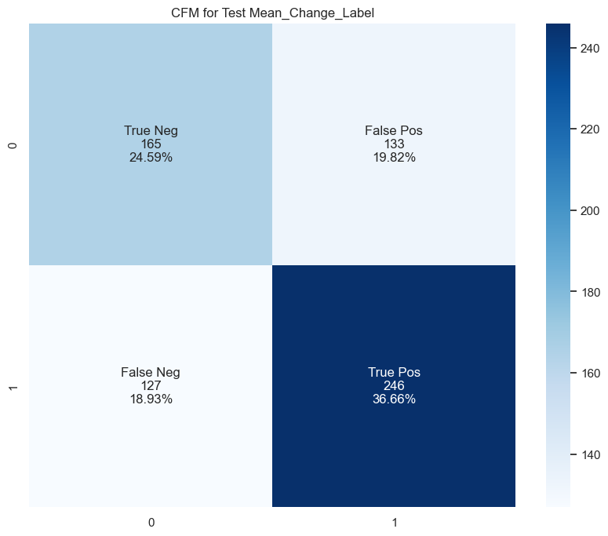
Logistic Model
 | Scores
Accuracy | 0.612519
F1-Score | 0.654255
ACU_ROC | 0.606604
Notes:
From the confusion matrix, we can also see that the correctly predicted negative and positive are higher.
And the model are more accurate on predicting the positive stock trend label.

Slide 11
Top words from Logistic Model
Word | Coefficient
trump | 1.732485
recess | 1.582953
actual | 1.378291
love | 1.231099
vaccin | 1.171420
exchang | 1.139246
advis | 1.107863
buyback | 1.089638
ceo | 1.079779
shift | 1.072818
Word | Coefficient
book | -1.631081
selloff | -1.587054
stagflat | -1.431557
myth | -1.386647
break | -1.345357
earli | -1.281100
omicron | -1.275406
polici | -1.245375
sell | -1.244793
freedom | -1.215873
Notes:
This is the top 10 words we get based on the coefficient from Logistic model.
Some of those words are more related to financial content: such as the recess, exchange, buyback for the positive coefficient, and sellofff, break, stagflation for the negative coefficient.

Slide 12
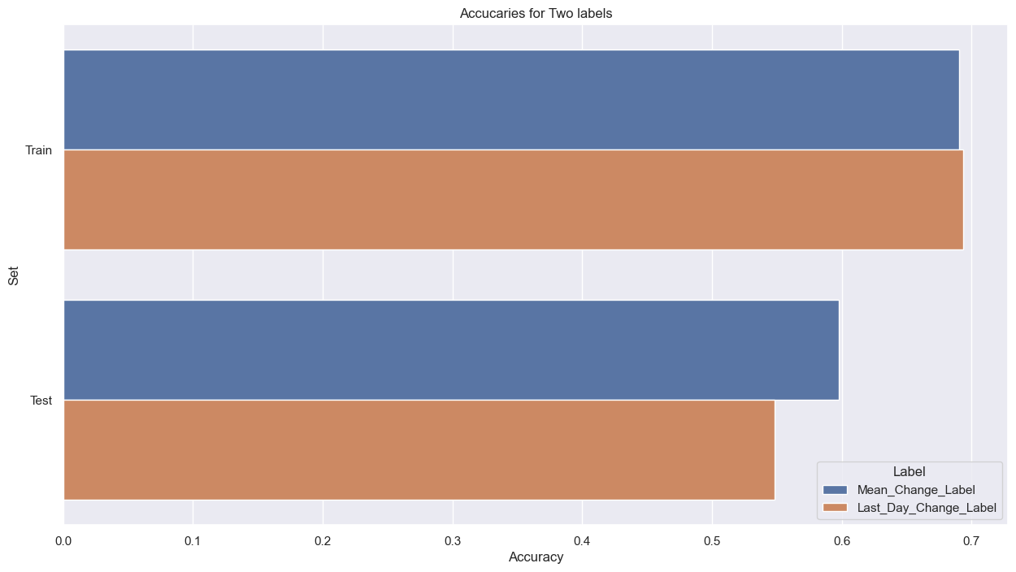
Naive Bayes Classifier Model
59.76%
54.84%
Notes:
Naive Bayes Model has a very similar performance as Logistic model, but its accuracy score is 1% lower than logistic model.

Slide 13
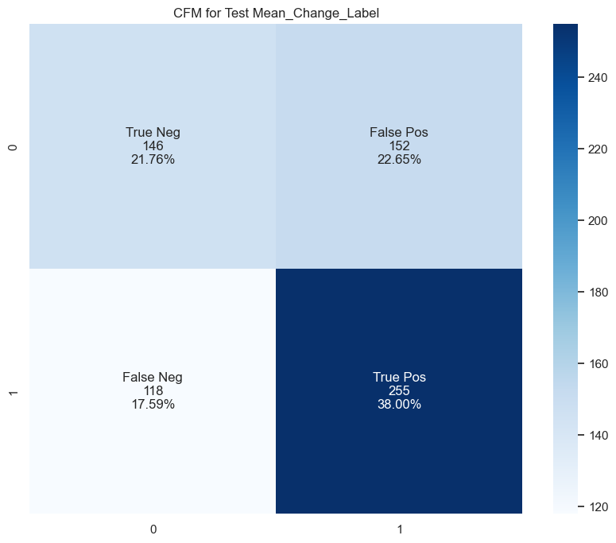
Naive Bayes Classifier Model
 | Scores
Accuracy | 0.597615
F1-Score | 0.653846
ACU_ROC | 0.586789
Notes:
And for the Naive Bayes Classifier, the F1 Score is also around 65%, but from the Confusion Matrix, we can see that the False Positive is higher than the one in Logistic Regression Model.

Slide 14
Bert Model
Tokenization
Text
tokenizer
input_ids,
hidden_masks
labels
Dataloader
batch size = 32
Labels
Pre-trained
Model
Fine Tuning
Hyper-parameter
(epochs num)
loss & hidden states for each apochs
Evaluation
Notes:
We chose the bert the model to do a further study.
We started from tokenization using bert-base-uncased tokenizer , generated input_ids and attention_masks. and merged with labels.
After that we used batch size of thirty two to build a dataloader, and load the pretrained model to train it.
we tried several epoch numbers and chose epochs = 20 and train the model.
During the training, we recorded the hidden states and loss for each epochs for further analysis.
At last, we use test data to do the model evaluation

Slide 15
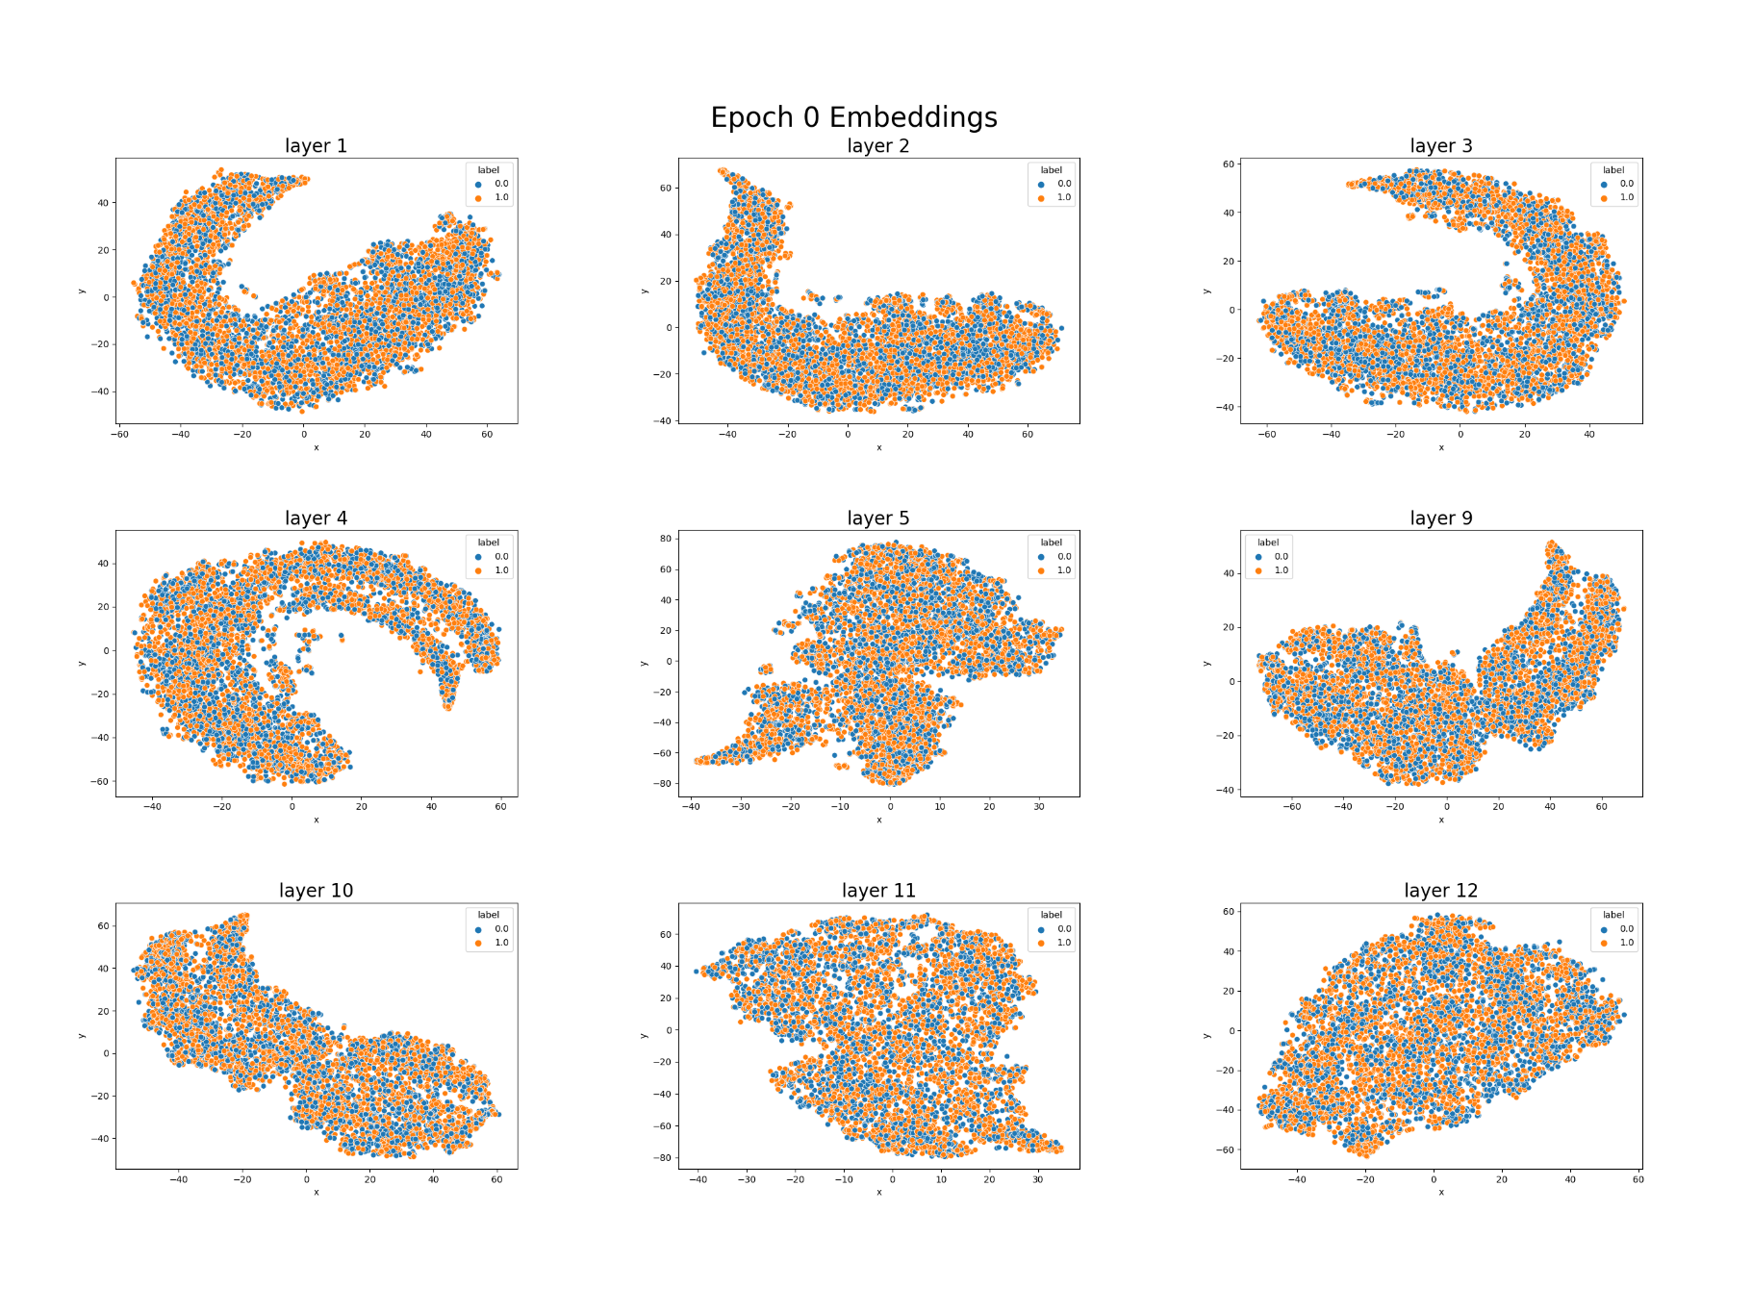
Bert Model
TSNE Visualization:
Reducing the 768 dimension in Bert hidden states to 2
Notes:
Here is a visualization of the hidden states. We used a TSNE method to reduce the layer average hidden states from 768 dimensions in each layer to 2 dimension, and draw a scatter plot of it. After filling the scatter points with the ground truth model, we can have a clear view on the hidden states and how the model could separate the classes through the learning. This is the plot for our first epoch. Each data point is the layer average hidden states for one input sentence.

Slide 16
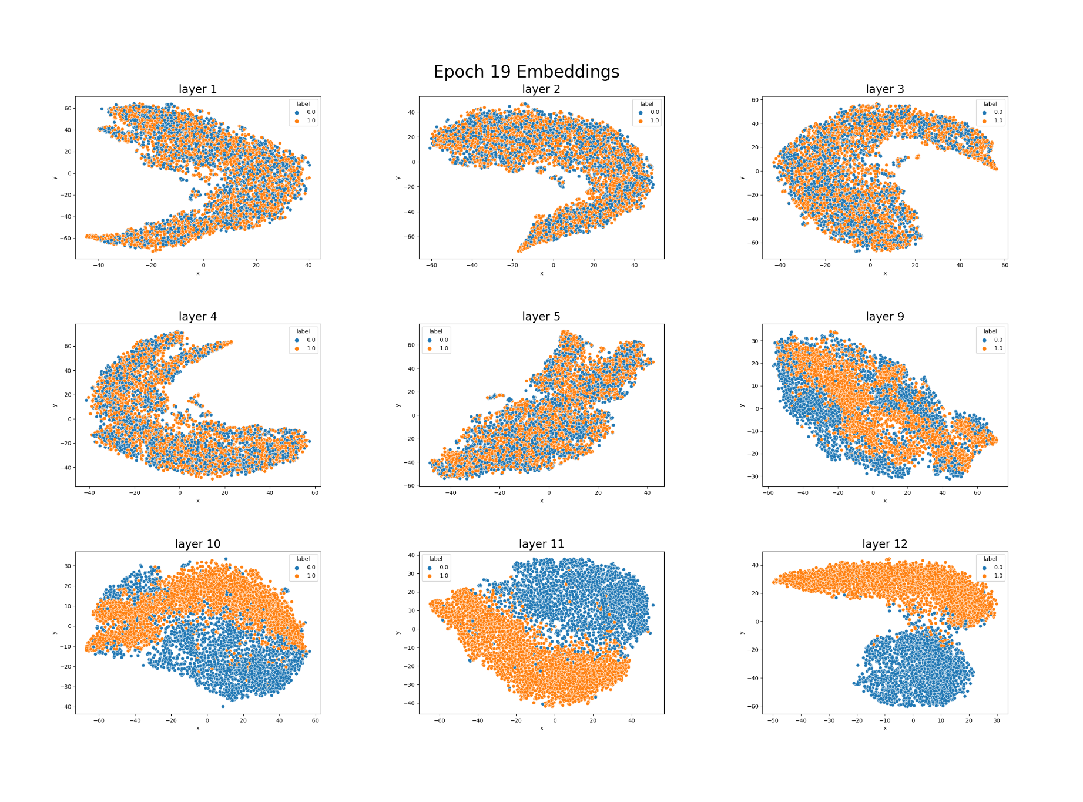
Bert Model
TSNE Visualization:
Reducing the 768 dimension in Bert hidden states to 2
Notes:
This is the plot for our last epoch, we can see that the last hidden state here matches the ground truth label well. Thus, we believe our model could makes a good classification for the training data.

Slide 17
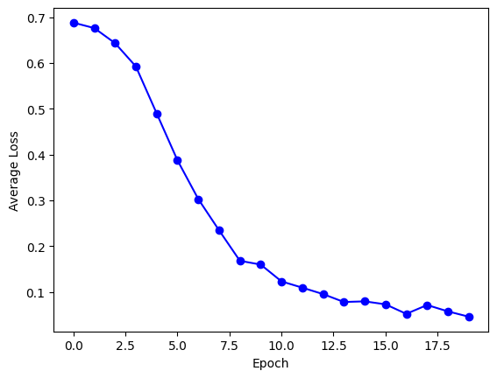
Bert Model
Loss changing with epochs
Notes:
The loss scores confirm our thought. The is the plot of average loss changing with epochs. We can see that with the increasing of epoch numbers, the average loss decreases. this means the model are learning through traing, and at last, the lost score is very low, which means a good performance on training data.

Slide 18
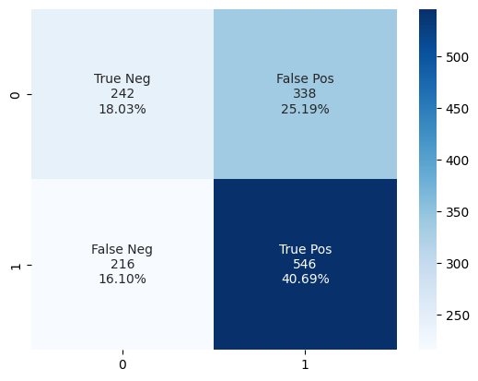
Model Accuracy
 | Scores
Accuracy | 0.587183
Precision | 0.573016
Recall | 0.566888
Macro F1 | 0.564854
Notes:
Our study above shows a good performance of the model on training data, however, when evaluating the model on the test data, we found that the model doesn’t have a good performance on these new data as we expected. We have metric scores right here, and we can see that the model has a worse performance on testing data compare to our other models.

Slide 19
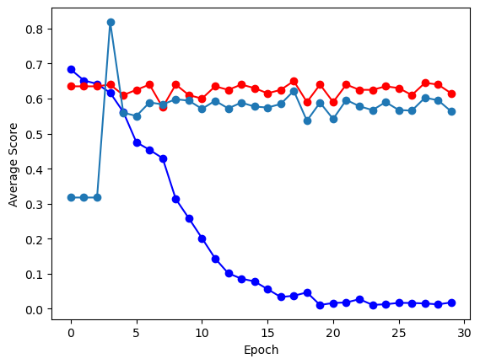
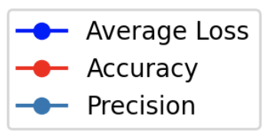
Problems with the training
Notes:
This bad performance is surprising to us. To see the reason, we run a model evaluation after each epochs’ training and store the accuracy and precision. We can see that though our loss decreased a lot, the accuracy and precision did not change too much. This means that though the model learns from the training data set and has a low average loss in the end, the features it learns through the epochs cannot give a good prediction on data outside the training batches. and the model might also have a overfitting

Slide 20
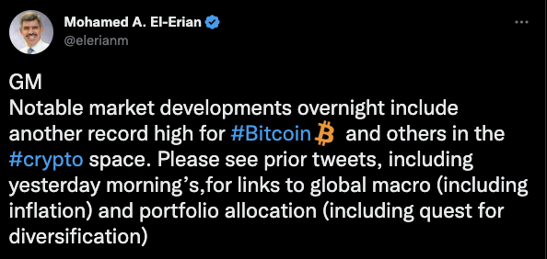
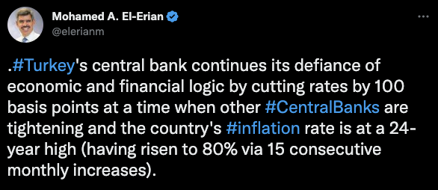
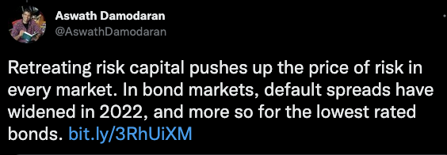
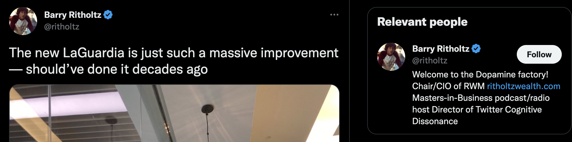
Bert Model:
Example from test data
Successfully prediction of stock price going up:
Successfully prediction of stock price going down:
Failed to predict:
News about other countries
Irrelevant tweets
Notes:
To further check our prediction, we traced back to the original tweets in the test data. Here are some example from the test data:
we can see that the model can actually make some good predictions over these straightforward tweets. However, though the tweets are from selected financial tweets, it has some irrelevant tweets, like news about other countries and tweets about blogger’s daily life, and these could become noise for the model and affect the training and testing. This is some work we did so evaluate and modify our bert model, and Yunhan would discuss prediction and conclusion based on our models in the following part

Slide 21
Prediction
Text Entry
Text Cleaning Pipeline
Loaded Vectorizer
Logistics
Loaded Model
Other Possible Models
Predicting
Result: Rise/Fall
Notes:
Here comes the prediction part. We saved our vectorization and logistics models to a pkl file, which is easy to save and load by the joblib package. This library enables us to save trained sklearn models to binary files and they are easily loadedj back. According to our model evaluation work, the logistic model stands out and we use this as our prediction model, and it is substitutable to other models. This script will ask for a text as input and predict if the index will rise or fall. The prediction script works like this. First, it will load two saved models, and take the text entry cleaned, lementized, stemmed, and, vectorized. Then it send the text matrix to the logistic model znc output its prediction: a rise or fall in the future. Let's see how the sample script work in practice.
Just type in python predict.py, then the script will run by itself. Then it will ask for a text entry. I found two tweets just before the presentation, one from morgan stanley, and one from goldman sachs. We can start with Goldman Sachs' tweets. This tweet is quite positive, and let's see how the script predict. And the Morgan Stanley's tweet is the opposite. The script predicted this correctly. What a luck.

Slide 22
Conclusion, Drawback, and Further Works
Notes:
In sum, we conclude that tweets are not the great source of predicting future stock indices. Even though, a 60% accuracy model is still better than a random guess, which is quite promising. We suspect the accuracy is not that satisfying caused by, first the tweets are too noisy to draw a serious classification conclusion. We can see that even in our selected accounts, some posts are still quite personal and will not contribute to our model. Second, maybe there is an ideal model, but we have not found it yet. Or the ideal model is a mixture of some models. Third, we are limited by computational power. We see BERT is not learning the correct features under current conditions, but it does not mean further hyperparameter tuning cannot improve its performance.
We might do these to further develop this project. First, it is possible to develop a new filter to only keep posts relevant to our model. Or we can use financial reports, or news to substitute tweets as the text input. Second, We may try to add the NB model to validate the logistic model output. The predicted results of these two models will be collected and used to train an NB based activation function. By combining these, we are expecting further improvement. Lastly, better GPUs will help us fine-tune deep learning models and increase the performance.
All citations are attached in the last page of this slides. One might check the links after the presentation.

Slide 23
Questions?

Slide 24
Citations
Parker, Tim. “10 Twitter Feeds Investors Should Follow.” Investopedia, Investopedia, 26 July 2022, https://www.investopedia.com/financial-edge/0712/10-twitter-feeds-investors-should-follow.aspx.
Mukhopadhyay, Sayantan. “Top 24 Best Twitter Profiles to Follow in Finance.” WallStreetMojo, 14 July 2022, https://www.wallstreetmojo.com/twitter-profiles-to-follow-in-finance/#h-1-paul-kedrosky-pkedrosky.
Dellatto, M. (2022) Eli Lilly clarifies it's not offering free insulin after tweet from fake verified account-as Chaos unfolds on Twitter, Forbes. Forbes Magazine. Available at: https://www.forbes.com/sites/marisadellatto/2022/11/10/eli-lilly-clarifies-its-not-offering-free-insulin-after-tweet-from-fake-verified-account-as-chaos-unfolds-on-twitter/?sh=55a8129e51a3 (Accessed: December 1, 2022).
Tassi, P. (2022) 'middle finger mario' becomes mascot of Elon Musk's Twitter blue verification free-for-all, Forbes. Forbes Magazine. Available at: https://www.forbes.com/sites/paultassi/2022/11/10/middle-finger-mario-becomes-mascot-of-elon-musks-twitter-blue-verification-free-for-all/?sh=de81b1e25a63 (Accessed: December 1, 2022).
Garg, T. (2021) Visualize Bert Sequence Embeddings: An unseen way, Medium. Towards Data Science. Available at: https://towardsdatascience.com/visualize-bert-sequence-embeddings-an-unseen-way-1d6a351e4568 (Accessed: December 1, 2022).

